Slide 1
UNIVERSITY INSTITUTE OF COMPUTING
Master of Computer Applications
Major Project
22CAR-753
Hidden Object Hunting Game
An Overview
of Computing
&
Career Planning
Student Name: Prafful Raghaw
UID: 22MCA20333
Section/Group: 8/B
Supervisor Name: Navdeep Singh Sodhi
Employee Code: E13472
Designation: Professor
Major Project Presentation
DISCOVER . LEARN . EMPOWER

Slide 2
Presentation Outline
Introduction to Project
Technology Used
Existing Gaps & Project Features
Objectives
Scope/Relevance
Project Flow Diagram
ER Diagrams
Test Cases
Comparative Analysis
Conclusion & Future Aspects
Bibliography
Note: In Conclusion kindly mention Software Model used & Project Cost

Slide 3
Introduction to Project
Title: Hidden Object Hunting Game
1. Overview: Utilizing Java, Java AWT, Java Swing, and MySQL, the Hidden Object Hunting Game provides an immersive experience.
2. Cognitive Development: This game entertains while enhancing observation and problem-solving skills, making it relevant in modern gaming.
3. Accessibility: Its availability across platforms underscores its significance in the gaming landscape.
Note: In Conclusion kindly mention Software Model used & Project Cost

Slide 4


Technology Used
1. Java Overview:
Widely-used, platform-independent language with OOP features.
2. Java AWT (Abstract Window Toolkit):
Original Java GUI toolkit.
3. Java Swing:
Modern GUI toolkit for Java applications.
4. MySQL Overview:
Open-source relational database system.
5. Problem-solving Techniques:
Algorithmic search, logical puzzles, iterative development.
Note: In Conclusion kindly mention Software Model used & Project Cost

Slide 5
Existing Gaps & Project Features
Analysis of existing hidden object games
Unique features of your game:
Graphics quality
Level design
User interface
Sound effects
Replayability
Graphics Quality
User Interface
Replayability
Level Design
Sound Effects
Note: In Conclusion kindly mention Software Model used & Project Cost

Slide 6
Objectives
Clear objectives of the project:
Entertainment
Cognitive development
Challenges for players
Learning experience for developers
Note: In Conclusion kindly mention Software Model used & Project Cost

Slide 7
Scope/Relevance
Scope of the project:
Target audience
Platform compatibility
Relevance of hidden object games in the gaming industry
Potential for expansion and updates
Note: In Conclusion kindly mention Software Model used & Project Cost

Slide 8
Project Flow Diagram
Flowchart illustrating the process from start to finish:
Main menu
Level selection
Gameplay
Scoring
Level completion
High scores
Options/settings
Exit
Note: In Conclusion kindly mention Software Model used & Project Cost

Slide 9
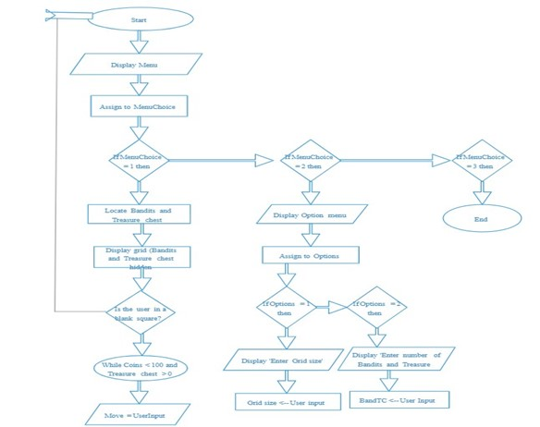
ER Diagram
Note: In Conclusion kindly mention Software Model used & Project Cost

Slide 10
Test Cases
Examples of test cases for different aspects of the game:
Functionality testing
Usability testing
Performance testing
Compatibility testing
Security testing
Note: In Conclusion kindly mention Software Model used & Project Cost

Slide 11
Comparative Analysis
Comparison with other popular hidden object games:
Graphics
Gameplay mechanics
Replay value
User reviews and ratings
Note: In Conclusion kindly mention Software Model used & Project Cost

Slide 12
Conclusion & Future Aspects
Summary:
Our game, developed using Agile methodology, offers an engaging experience.
Software Model Used:
We utilized Agile development for flexibility and adaptability.
Project Cost:
Costs were managed efficiently, leveraging open-source tools and careful resource allocation.
Note: In Conclusion kindly mention Software Model used & Project Cost

Slide 13
Bibliography
https://github.com/
https://www.google.co.in/
https://www.geeksforgeeks.org/
Note: In Conclusion kindly mention Software Model used & Project Cost

Slide 14
THANK YOU

